Slide 1

Predicting Stock Market Movements with the News Headlines and Deep Learning
Submitted by: Ashish Lakamale
Student ID: 18210227
Supervisor: Yvette Graham

Slide 2
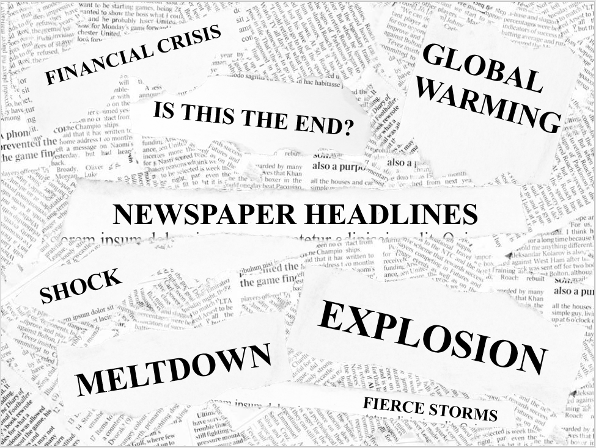
Business Understanding
What is Stock Market?
What affects stock Market prices?
Headline Effect?
Source: Presentation Magazine

Slide 3
Dow Jones Industrial Average (DJIA)
The Dow began in 1896 with 12 industrial stocks.
Dow Jones & Co was founded by journalists Charles Dow and Edward Jones.
Stock index comprised of 30 "blue-chip" US stocks.
3M, American Express, Apple, Boieng, IBM.
Sum of the price of one share of stock for each component company.

Slide 4
Intention
DJIA opening price prediction using news headlines.
“Dow tumbles 800 points after bond market flashes a recession warning.”
“Trade war tensions send China's yuan to 11-year low.”
“Trump says US and China to resume trade talks.”
“As EU threatens trade retaliation, Brazil fights Amazon fires.”

Slide 5
Text Classification Approach
Read Documents
Feature Extraction
Tokenization, ngrams , stemming
Feature Selection
Information Gain(IG)
Vector Representation
Binary, tf-idf
Learning Algorithm
Naïve bayes, logistic regression, SVM, decision trees
Read Documents
Tokenize, Embedding
Network Design
CNN, RNN, number of layers
Parameter Tuning
Traditional Approach
Deep Learning Approach

Slide 6
Traditional Vs Deep Learning Approach
Traditional Approach | Deep Learning Approach
Well Understood More than 2 decades of active research Successfully used in many applications | Nascent, started around 2014-2015
More number of steps and several choices for each Less number of steps Right choices are well established | Less number of steps
Major time is spent on feature engineering | Major time is spent on parameter tuning
Easy to serve model in real time | Real time serving of model can be challenging
it is hard to beat the accuracy of traditional approach in text classification!!!

Slide 7
Project Pipeline
News Headline
Historical Price
GloVe
Common Crawl
Data Preparation
Word Embedding
Normalization
CNN
LSTM
CNN-LSTM
Modelling
Results
Evaluation

Slide 8
Data Understanding
Data contains 102,527 news headlines for DJIA companies.
Divided into 70:30 training(71769) and testing(30758) data
2771 days since 08/08/2008.
On average 37 headlines per day.
Labelled CSV file for headlines and stock opening price.
Data Source
1. https://finance.yahoo.com/
2. https://www.alphavantage.co/
3. https://www.macrotrends.net
4. https://kaggle.com

Slide 9
Data Preparation
Removing special characters and punctuations.
Removing numbers from text.
Correcting misspells.
Removing contractions.
Target Values.
Word Embedding.

Slide 10
Data Preparation – GloVe Vector
GloVe, coined from Global Vectors, is a model for distributed word representation.
Pre-trained vector, GloVe’s common crawl vector is used.
Unsupervised learning algorithm for obtaining vector representations for words.
2.2M word embeddings, each with 300 dimensions.
Created embedding matrix.

Slide 11
Models
Convolution Neural Network (CNN)
Long Short Term Memory (LSTM)
Combined CNN and LSTM architecture + random embedding
Combined CNN and LSTM architecture + GloVe’s embedding

Slide 12
Convolution
What is Convolution?
Sliding window function applied to a matrix.
Video source : http://ufldl.stanford.edu/tutorial/supervised/FeatureExtractionUsingConvolution/

Slide 13
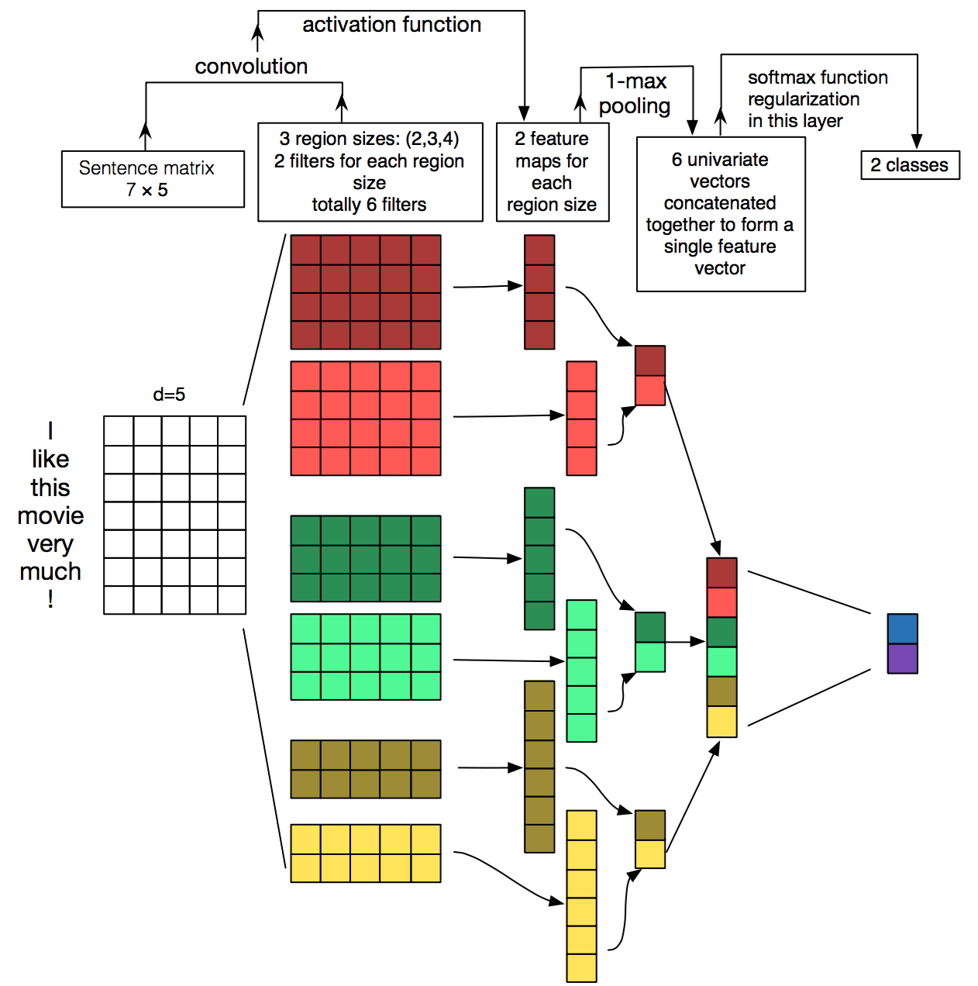
CNN architecture for sentence classification
Image source: http://www.wildml.com/2015/11/understanding-convolutional-neural-networks-for-nlp/

Slide 14
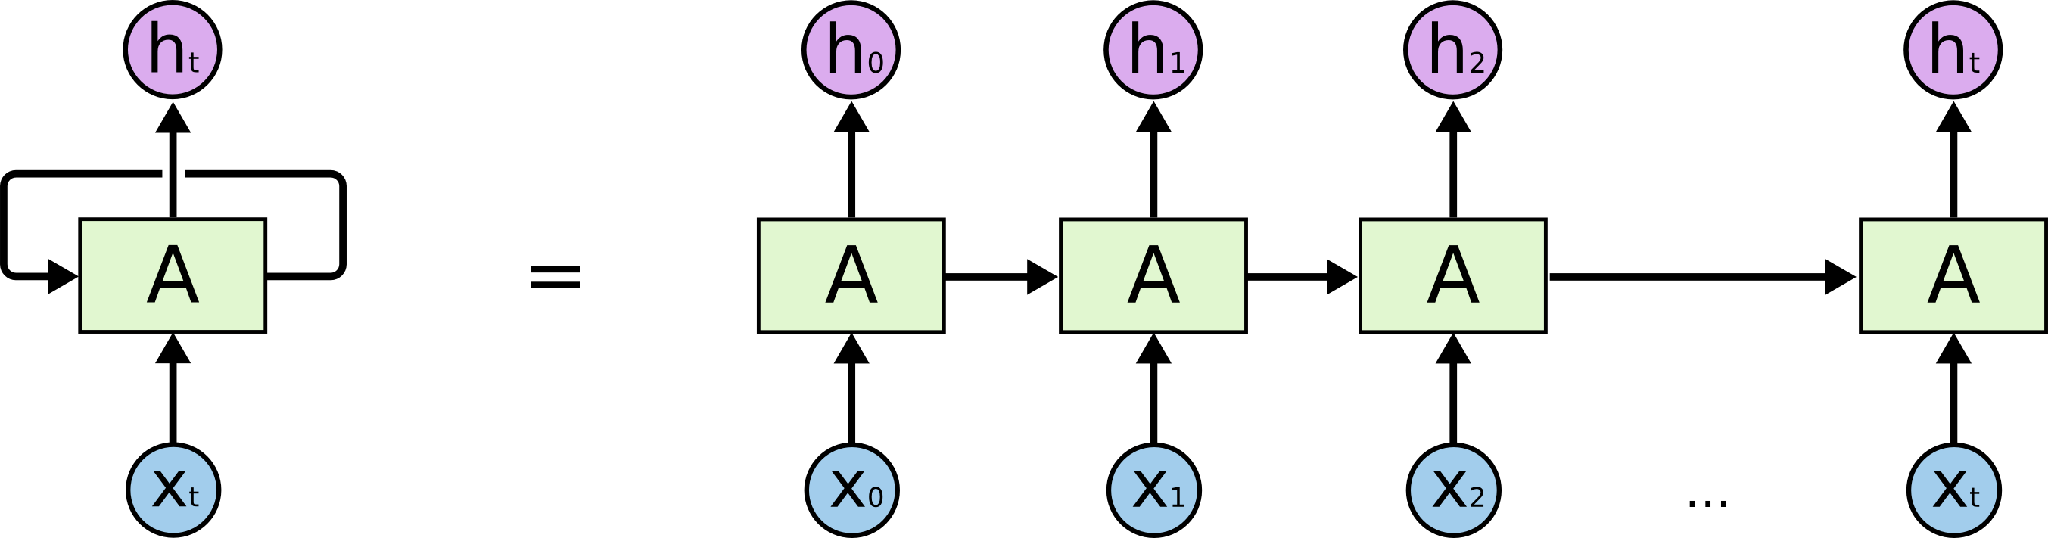
Recurrent Neural Network (RNN)
What are RNNs?
Use of sequential information.
All inputs (and outputs) are dependent of each other.
I grew up in France… I speak fluent French.
An unrolled recurrent neural network.
Image source: http://colah.github.io/posts/2015-08-Understanding-LSTMs/

Slide 15

Long Short Term Memory (LSTM)
Long Short Term Memory networks are a special kind of RNN.
Capable of learning long-term dependencies.
Image source: http://colah.github.io/posts/2015-08-Understanding-LSTMs/

Slide 16
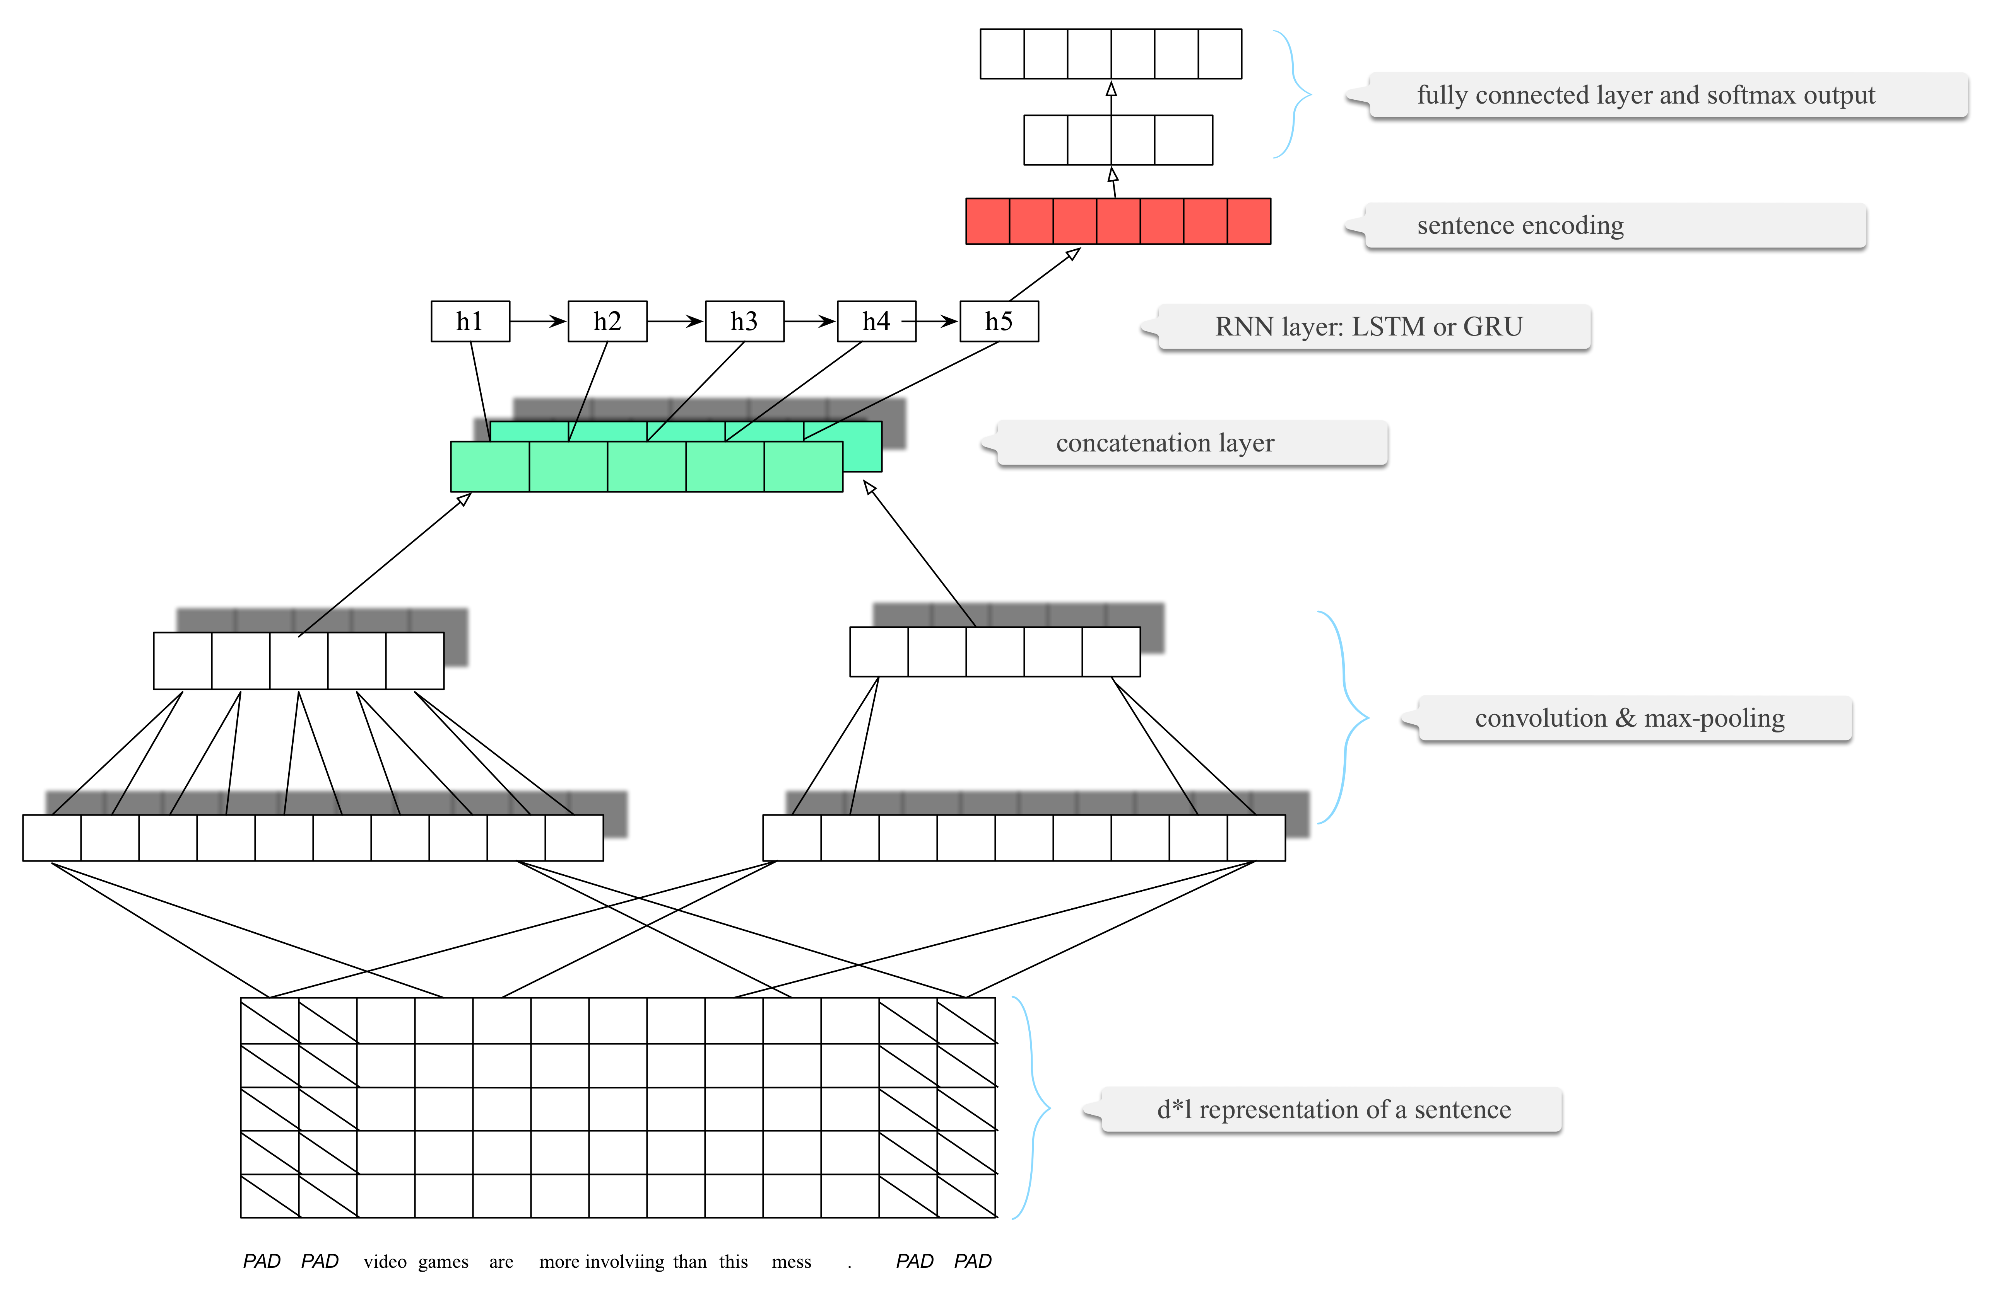
Combined Architecture
Image source: http://www.wildml.com/2015/11/understanding-convolutional-neural-networks-for-nlp/

Slide 17
Hyperparameter Tuning
The value of the hyperparameter has to be set before the learning process begins.
k in k-Nearest Neighbors
number of hidden layers in Neural Networks.
Grid-search
It is used to find the optimal hyperparameters of a model which results in the most ‘accurate’ predictions.

Slide 18
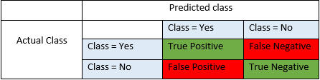
Evaluation
Mean Absolute Error (MAE)
Precision
Recall
Accuracy
F1 Score
 | $$MAE=\frac{1}{n}\sum_{i=0}^{n}{|x_{i}−x | }$$ | (1)
 | $$Precision= \frac{TP}{TP+FP}$$ | (2)
 | $$Recall= \frac{TP}{TP+FN}$$ | (3)
 | $$Accuracy= \frac{TP+TN}{TP+TN+FP+FN}$$ | (4)
 | $$F1 Score=2∗\frac{Recall ∗Precision}{Recall+Precision}$$ | (5)

Slide 19
Results
Model | Accuracy | Precision | Recall | F1 Score
LSTM + tf-idf | 0.5476 | 0.5474 | 0.5476 | 0.5458
CNN + tf-idf | 0.5079 | 0.5075 | 0.5079 | 0.5091
Model | MAE | Actual Direction
CNN + LSTM + rand | 74.15 | 51.78
CNN + LSTM + GloVe | 59.15 | 55.52

Slide 20
Conclusion
Adapting GloVe’s pretrained vectors provides improved results than random initialized vector.
Very deep convolutional networks are not always the answer.
Getting better results with less deeper neural network
More news headlines were required to extract semantic information.

Slide 21
Future work
Collect individual headlines for DJIA components.
Modifying architecture to handle long text classification task.

Slide 22
Demo

Slide 23
Credits for Code
Glove vector from Stanford’s GitHub repository
Combined CNN and LSTM architecture form Kaggle competition tutorial.
Actual direction metric
https://nlp.stanford.edu/projects/glove/
https://github.com/hiaoxui/text-classification-with-CNN-LSTM
https://www.aclweb.org/anthology/C16-1229/

Slide 24
Thank you!

Slide 25
Hyperparameter Tuning
Method | Accuracy
Baseline
More filters of size [2,3,4,5,6]
Dropout probability from 0.5 increased to 0.75
Batch size 2048 instead of 512
Batch size 64 instead of 512

Slide 26
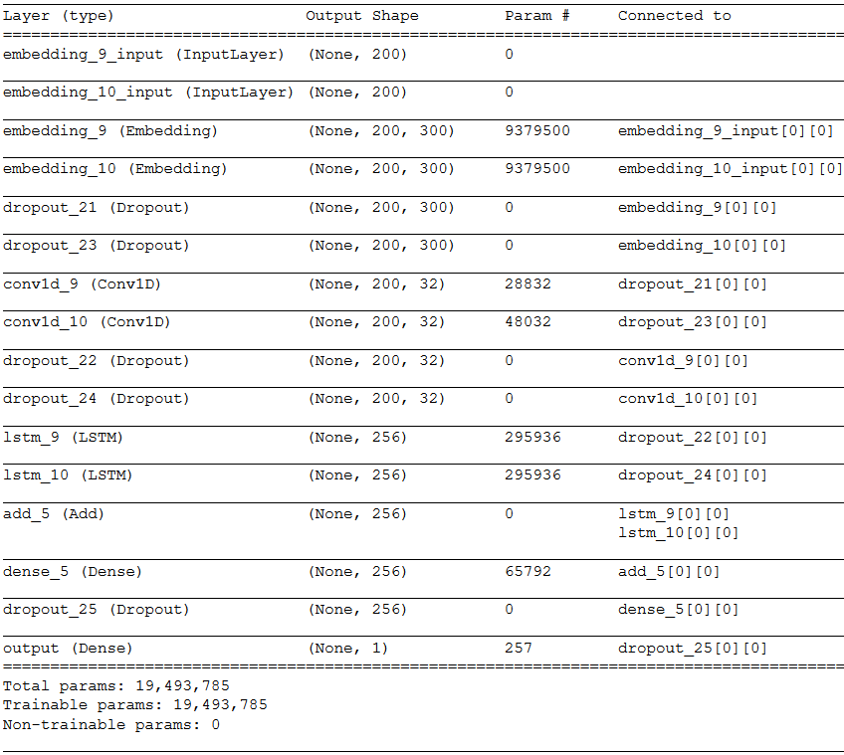

Slide 27
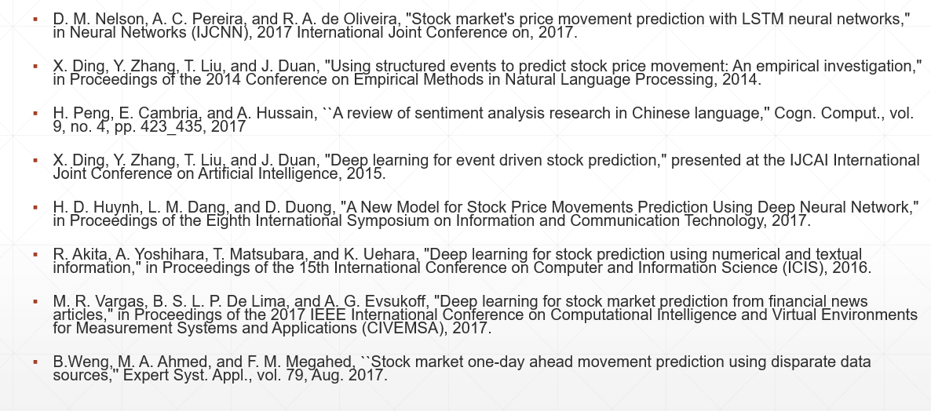
References

Slide 28
